Slide 1
Sudanese (Darfur)
Genocide
Presented by:
Dignos, Lunesa, Oñez, Panerio, Talisaysay

Slide 2

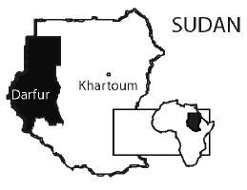
known as “Darfur Genocide”
western region of Sudan, Africa and is about the size of France
the current mass slaughter and rape of Darfuri men, women, and children in Western Sudan

Slide 3
In 1989, a man named General Omar al-Bashir staged a coup d'etat; he used the military to take over the Sudanese government and made himself the leader of Sudan.
The National Islamic Front became the new government; Bashir and his new regime are considered largely responsible for the problems that grew in Darfur.

Slide 4
After Bashir took power, farmers in Darfur claimed that the National Islamic Front no longer protected their interests against the nomadic tribes that moved in and out of the region.
These nomads committed crimes, violated property rights, and even hurt the people living there.
Bashir's government turned a blind eye, so the people of Darfur formed two different rebel groups that decided to fight back against their do-nothing government: the Sudan Liberation Army (SLA) and the Justice and Equality Movement (JEM).

Slide 5
In 2003, Bashir responded to the SLA and the JEM in two ways.
First, he ordered the military to fight the two rebel groups.
Second, he sent a number of Arab militias to terrorize the people living in Darfur. Referred to as the Janjaweed, or 'devils on horseback', the militias rode into villages on horses or camels and terrorized the people living there. They murdered, raped, and pillaged, leaving over 400 villages in complete ruin and countless people without a home.

Slide 6
the killings began in 2003, as the first genocide in the 21st century
on-going conflict iwas declared “genocide” by United States Secretary of State Colin Powell on September 9, 2004, in testimony before the Senate Foreign Relations Committee
The dispute is racial, not religious: Muslim Arab Sudanese are killing Muslim black Sudanese.
Notes:
on-going conflict in Darfur, Sudan was declared “genocide” by United States Secretary of State Colin Powell on September 9, 2004, in testimony before the Senate Foreign Relations Committee
IN DETAIL:
In 1989, a man named General Omar al-Bashir staged a coup d'etat; he used the military to take over the Sudanese government and made himself the leader of Sudan. The National Islamic Front became the new government; Bashir and his new regime are considered largely responsible for the problems that grew in Darfur. Conflict After Bashir took power, farmers in Darfur claimed that the National Islamic Front no longer protected their interests against the nomadic tribes that moved in and out of the region. These nomads committed crimes, violated property rights, and even hurt the people living there. Bashir's government turned a blind eye, so the people of Darfur formed two different rebel groups that decided to fight back against their do-nothing government: the Sudan Liberation Army(SLA) and the Justice and Equality Movement(JEM). In 2003, Bashir responded to the SLA and the JEM in two ways. First, he ordered the military to fight the two rebel groups. Second, he sent a number of Arab militias to terrorize the people living in Darfur. Referred to as the Janjaweed, or 'devils on horseback', the militias rode into villages on horses or camels and terrorized the people living there. They murdered, raped, and pillaged, leaving over 400 villages in complete ruin and countless people without a home.

Slide 7
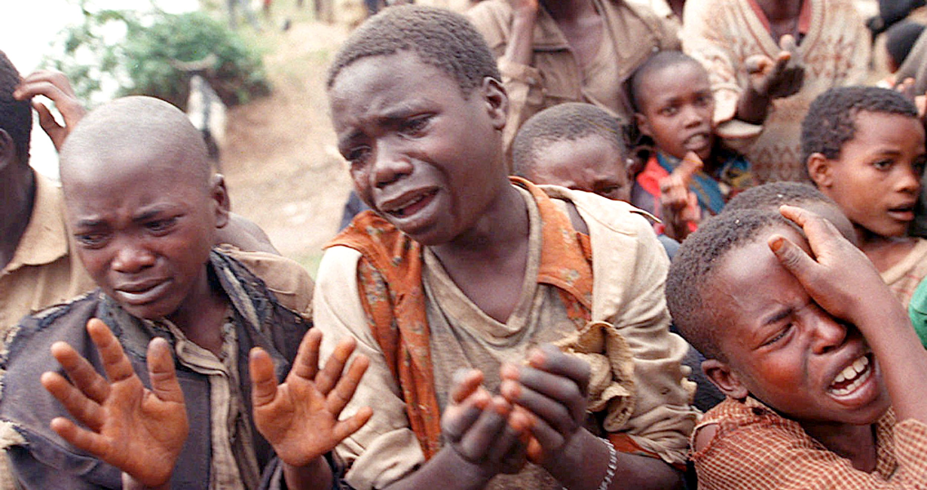
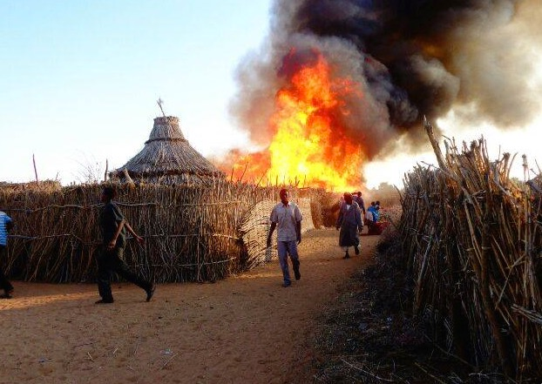
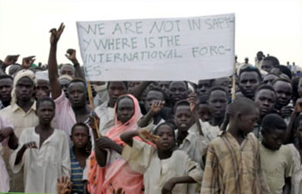
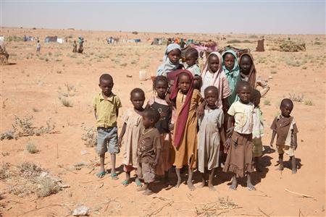

Slide 8
Janjaweed & Violence
Janjaweed are the armed militia supported by the Sudanese Government to carry out the genocide, alongside and independent of, the Sudanese Army.
will enter a village on horse or camel back
then set about causing as much mayhem and terror as possible
systematically destroy Darfurians by burning villages, looting economic resources, polluting water sources, and murdering, raping, and torturing civilians
'devils on horseback’
Notes:
Janjaweed -- is being carried out by a group of government-armed and funded Arab
These militias are historic rivals of the main rebel groups, the Sudanese Liberation Movement (SLM), and the Justice and Equality Movement (JEM).

Slide 9
Amnesty International alleged that the government used chemical weapons against civilians. However, Sudan, a party to the Chemical Weapons Convention since 1999, denied the findings and limited the scope of investigation by the Organization for the Prohibition of Chemical Weapons (OPCW)

Slide 10
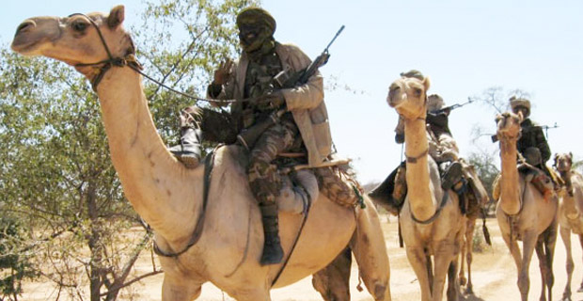
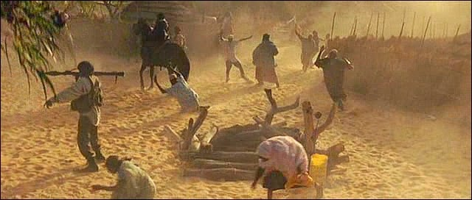

Slide 11
Who has been affected
Up to 400,000 people have died due as a result of direct attacks and conflict induced malnutrition and disease. The vast majority of these have been women, children and civilian men.
More than 3 million people have been displaced and are living in IDP camps
More than 350,000 people are deprived of humanitarian support due to the threat of attack faced by aid workers. Thousands starve each month due to the Sudanese government impeding humanitarian aid efforts
A further 4 million Darfuri residents are dependant on limited international humanitarian assistance. The violence is now spilling onto neighbouring Eastern Chad.

Slide 12
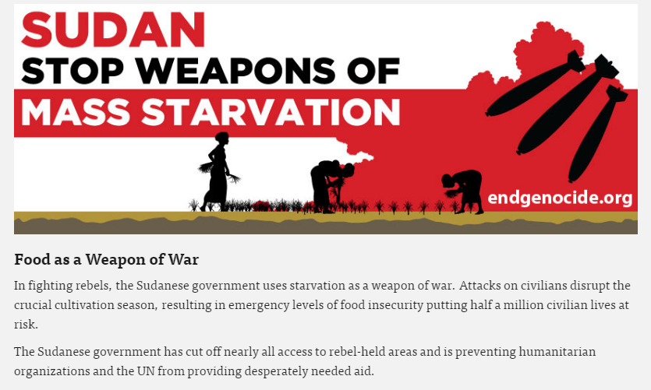

Slide 13
Why is it Continuing
The Sudanese Government have committed to allowing a 26,000 strong peace keeper force into the region they have continually showed their contempt for the people of Darfur. This shows a blatant disregard by the Sudanese Government of UN Security Council Resolution 1674, which gives the international community the 'Responsibility to Protect' civilians from genocide when governments fail to do so.
Government authorities continued to block the African Union/United Nations peacekeeping mission, UNAMID, from underminin the mission's ability to protect civilians.

Slide 14
While the confict has faded from the spotlight, ongoing violence continues to displace, injure and kill people today. The security situation continues to detoriate, with millions displaced, hundreds of thousands living as refugees, and millions in need of food and vital aid. The discovery of gold in Darfur has further fueled violence and displacement throughout the region, and conflict dynamics have since morphed from the initial outbreak of violence in 2003

Slide 15
References:
[1]
http://www.darfuraustralia.org/darfur/basics
[2] http://study.com/academy/lesson/the-darfur-genocide-in-sudan-history-facts-causes.html

